Slide 1
Parallel Video Processing
Group 9 0113110 陳柏翰 (資工系 大三) 0310511 孫 誠 (資工系 大二) 0316213 蒲郁文 (資工系 大二)

Slide 2
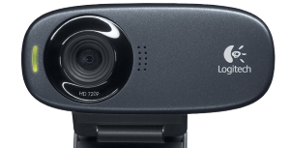

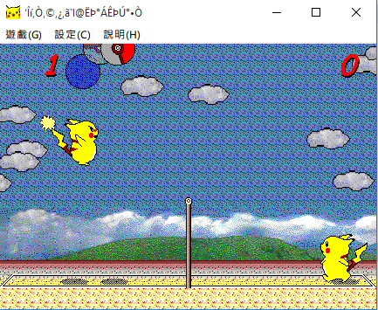

INTRODUCTION
What we initially intended to do: Face tracking
1280*720 @30fps
Track
Win API

Slide 3
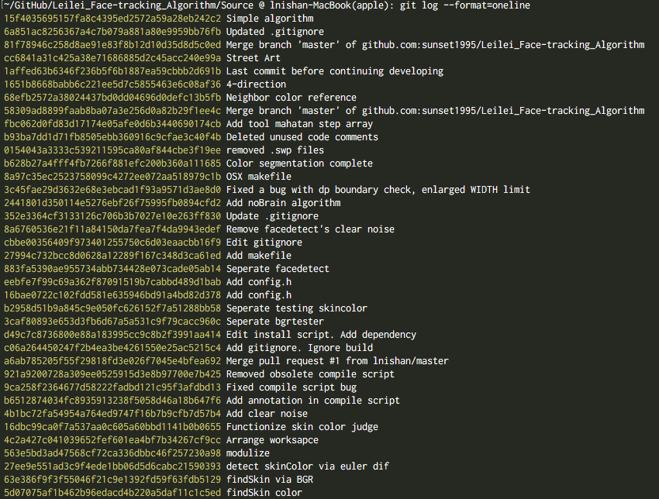
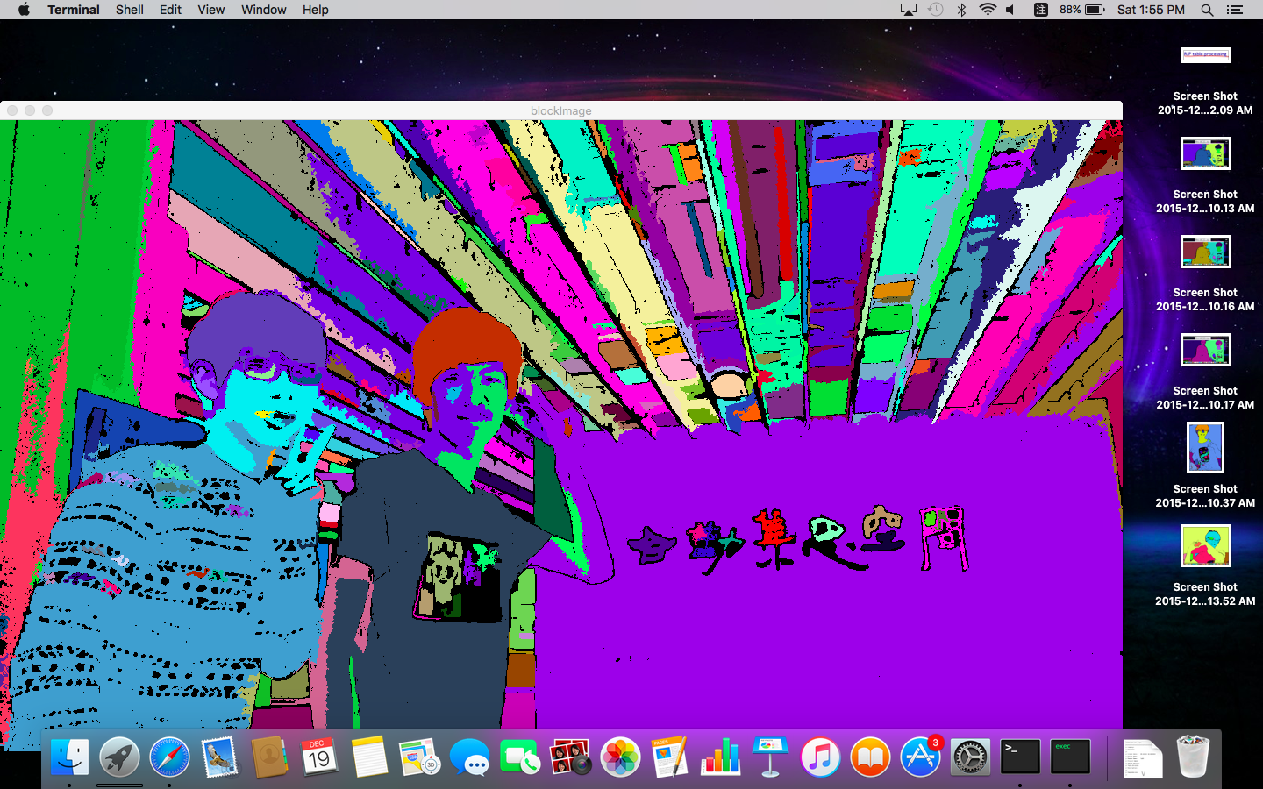
Introduction
Couldn’t get a stable result for gesture synthesis
Algorithm was already unsuitable for parallelization
Looked for existing APIs. Too hard/complicated.
O(N) speedup?
https://github.com/sunset1995/Leilei_Face-tracking_Algorithm

Slide 4



Environment Settings
Tools used:
APIs: OpenCV 2.4.11, OpenCV 3.0
PC: Win 10, i7-3770, 8GB *2, GTX670 VS12(2013), Cygwin gcc 5.2.0
NB1: Ubuntu 14.04, i5-4200H, 8GB, gcc 4.8.4
NB2: Mac OSX El Capitan, i5-4260U, 8GB, gcc 5.2.0
VPS: Ubuntu 15.10, 2 vCores, 2GB, gcc 5.2.0
FPGA: ML506 Evaluation Platform
Pthread
FPGA

Slide 5
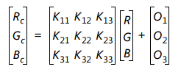
An investigation into O(N) parallelization
Previous experience says #pragma omp parallel for for (int i = 0; i < SIZE; i++) a[i] = something; => gives no speedup
Color Correction Matrix: Linear Transformation For each pixel…
=> O(N)

Slide 6
Lightup: An O(N) Experiment
Input: 360*240/1280*720/1920*1080 @30fps, 148 frames
Output 1: For each pixel, [R’, G’, B’] = 2 * [R, G, B] + 5 Then normalize the RGB values back to [0, 255].
Slowdown when input is small
Tiny speedup even when input is large
Similar results across OpenCV 2.4, Ubuntu, OSX.

Slide 7
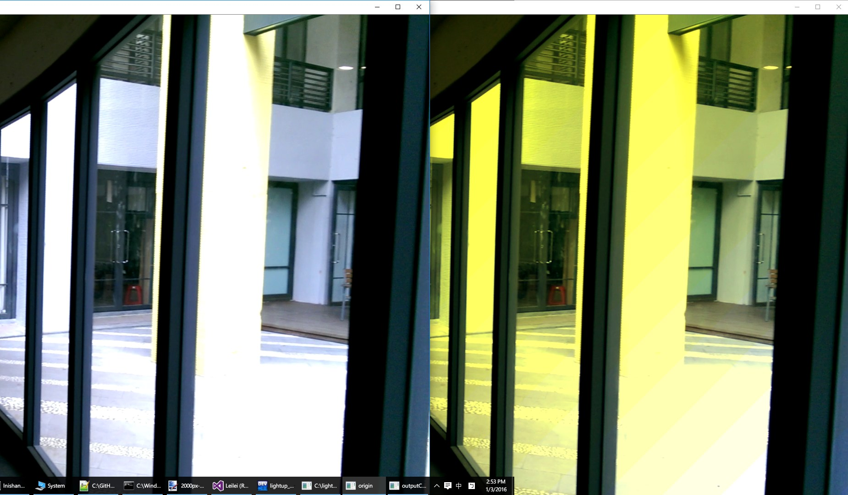
Lightup2: An O(N) Experiment
Input: 360*240/1280*720/1920*1080 @30fps, 148 frames
Output 2: For each pixel, [R’, G’, B’] = [R, G, B] * 1.125^[(x + y) / 128]

Slide 8
Lightup2: An O(N) Experiment
Results are clearly better
Time Division seems to be better than Frame Division
So, Impossible to speedup O(N) ?

Slide 9
Lightup2.5: An O(N) Experiment
How about FPGA?
Output 2.5: [R’, G’, B’] = [R, G, B] * 1.125^1024
Staggering results: > 300x speedup (256*256)
> 985x speedup (1920*1080)
… 100x faster than other methods
Hardware friendly
for (int i = 0; i < 1024; i++) value = value + (value >> 3);
Leave it till later~

Slide 10
Why no Speedup on CPU!?
Can different platforms be the issue?
No, we’ve tested on Windows, Ubuntu, and MacOSX.
Can optimization options be the issue?
No, Both -O0 and -O2 indicated that sequential is almost as efficient. We also tried –fno-reorder-blocks.
Can memory bandwidth be the issue?
We thought so, but actually no, even though there’s a certain limit in place.

Slide 11
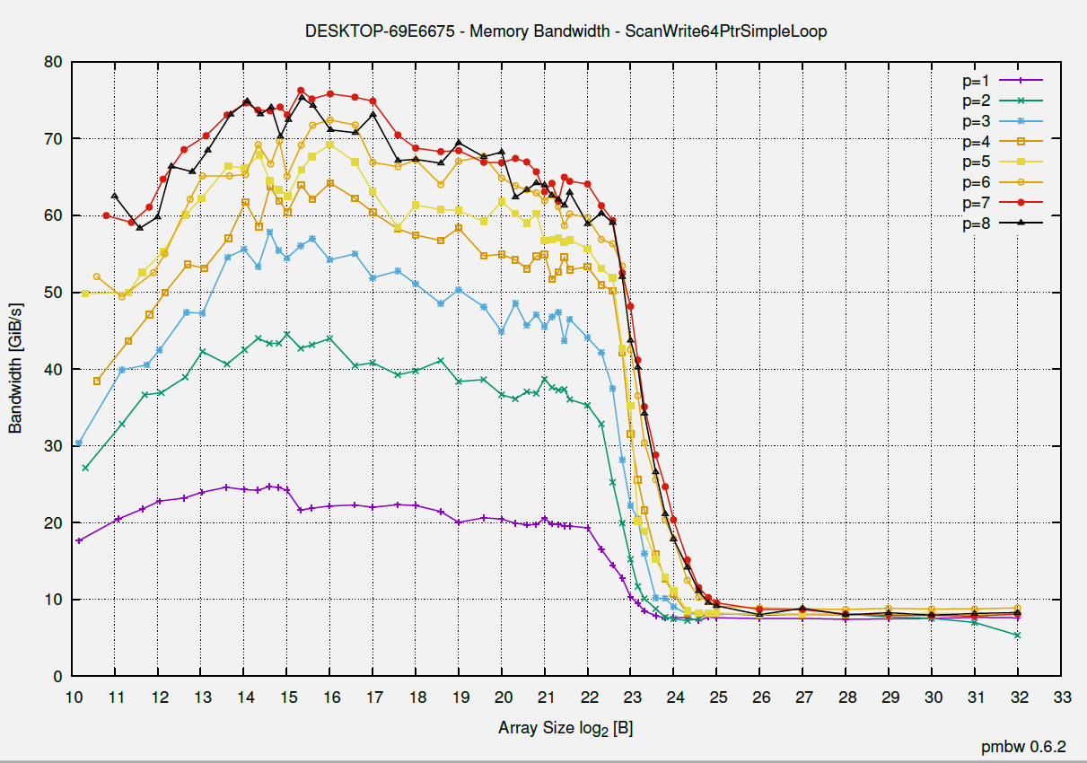
pmbw - Parallel Memory Bandwidth Benchmark

Slide 12
pmbw - Parallel Memory Bandwidth Benchmark
I/O is parallelizable
Speedup is definitely possible
The reason for no speedup seems to be Automatic Vectorization (by the compiler)
The speedup for I/O or I/O bound applications is ~3.1x maximum on the PC (i7, Win10)
~2x on NB1(i5, Ubuntu 14.04)

Slide 13
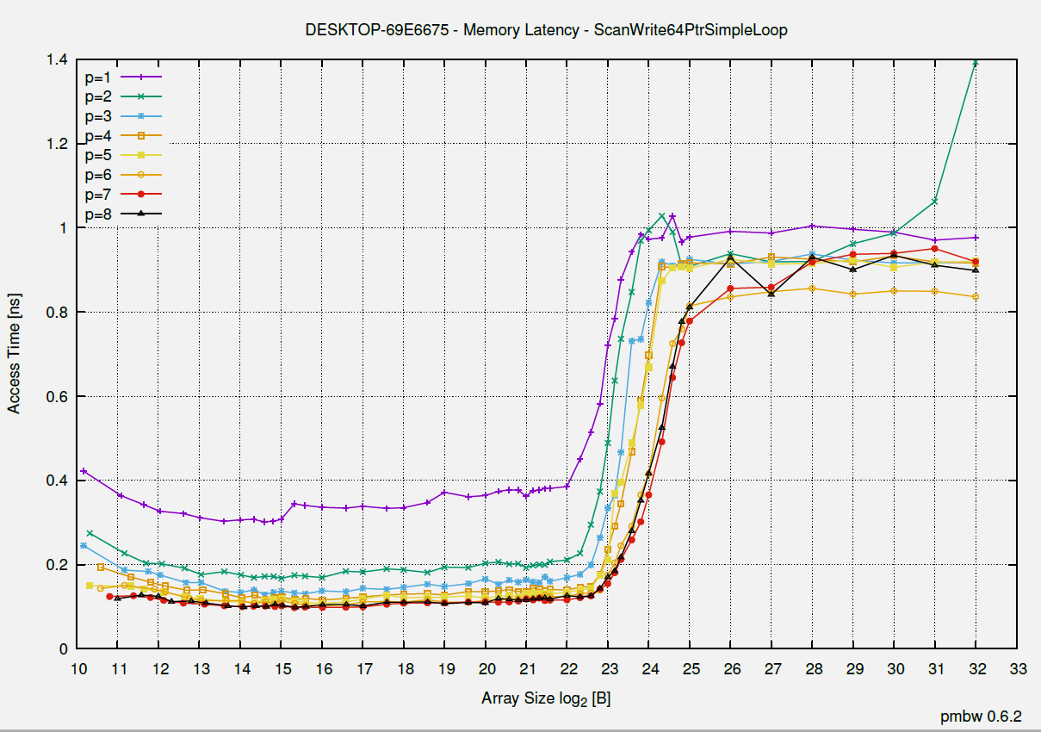
pmbw - Parallel Memory Bandwidth Benchmark

Slide 14
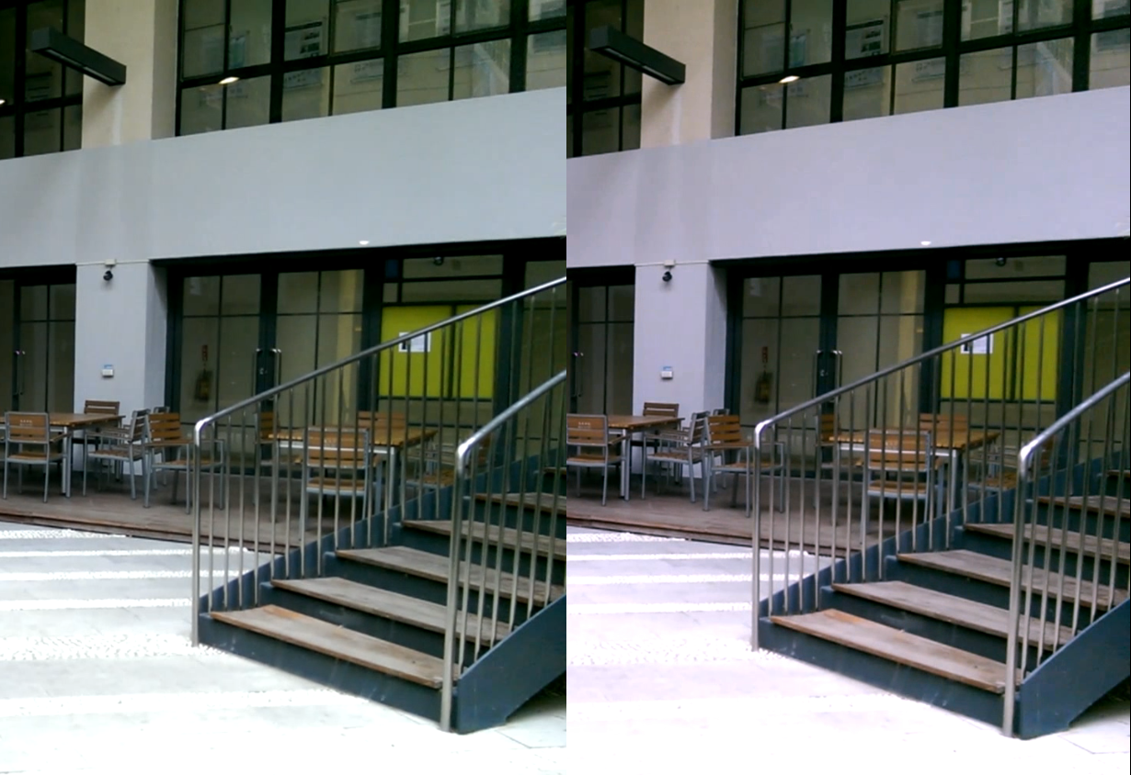
White Balance

Slide 15
Block Diagram
Input
Decode input video
Calculate
White balance
Output
Encode processed video
Parallelizable
Parallelizable

Slide 16
Algorithm
Top-level idea: make the averages of Red, Green and Blue values equal on an image
Algorithm:
Calculate the averages of Red, Green and Blue values, as denoted by (AvgR, AvgG, AvgB)
Using Green as reference, for each pixel, Red(new) = Red * AvgG / AvgR Blue(new) = Blue * AvgG / AvgB
If Red/Blue(new) > 255 Then Red/Blue(new) = 255
Gray World Algorithm, from http://web.stanford.edu/~sujason/ColorBalancing/grayworld.html

Slide 17
Parallel Methods
With scalability in mind and to prevent memory exhaustion,
We divide the input video into chunks with each containing no more than 500 frames.
500max
500max
500max
Chunk1, Apply method
Chunk2, Apply method
Chunk3, Apply method
Chunk4, Apply method

Slide 18
Parallel Methods
1. Pthread_TDM: C++11 Thread and Divide video by time
Thread 1
Frame1
Frame2
Frame3
Frame N … etc.
Thread 1
Thread 2
Thread 3
Thread 4
Frame1
Frame2
Frame3
Frame N … etc.
2. OpenMP_TDM: Same but with OpenMP as the API

Slide 19

Parallel Methods
3. CUDA: 1frame/iteration, Each thread processes 1 pixel
Blk1
Blk2
Blk3
Blk4
Blk5
Blk6
$\left\lceil \text{Rows}\text{ ∗ }\text{Cols}\text{ / 1024}\right\rceil$ blocks
● ● ●
1024 threads /block
4. CUDA_TDM
Block1
Block 2
Block 3
Block 4

Slide 20
Parallel Methods
5. Task parallel: Extended from Pthread_TDM (divide by time). Rather than waiting for Input and Calculate to finish, Create a separate thread specifically for output.
Input & Calculate
Finished, unlock
Finished, unlock
Mutex locks
Attempts to acquire lock
Output

Slide 21
Evaluation
First assume we don’t need to output (encode). Perhaps we would like it as a module
Data: 1280 * 720, 1422Frames (AVI)
Environment: i7-3770(4C8T), 2 Threads, VS12, Win10
~1.69x Speedup
~1.77x Speedup

Slide 22
More Threads
4 Threads
~2.49x Speed up
~2.56x Speed up
8 Threads
~3.02x Speed up
~3.00x Speed up
~3x matches with the memory bandwidth test result!

Slide 23
Other Platforms
NB1: i5-4260H(2C4T), 2~4 Threads, gcc 4.8.4, Ubuntu 14.04
~2.00x Speedup
~1.76x Speedup
VPS (2 vCores)
PC(i7) with Cygwin-gcc 5.2.0

Slide 24
Evaluation
When output is taken into account, task parallel delivers better results.

Slide 25
Task Parallel
This is especially true on NB1(Ubuntu 14.04)

Slide 26
Task Parallel
When output is taken into account, the whole process is actually output-bound

Slide 27
Conclusions
Face tracking without trained data is hard
Do not help the compiler, doing simple tasks sequentially is actually better sometimes
CUDA isn’t suitable for I/O bound applications
On the CPU side of things, certain limits posed by memory bandwidth matters
Input and Output video codec matters

Slide 28
Related Work
Illuminant Estimation: Gray World http://web.stanford.edu/~sujason/ColorBalancing/grayworld.html
Ching-Chih Weng, Homer Chen, and Chiou-Shann Fuh, “A Novel Automatic White Balance Method For Digital Still Cameras” Circuits and Systems, 2005. ISCAS 2005. IEEE International Symposium on http://www.csie.ntu.edu.tw/~fuh/personal/ANovelAutomaticWhiteBalanceMethodforDigital.pdf

Slide 29
Contributions
0113110 陳柏翰： CUDA, Cross platform compatibility, Automated Sync/Build/Test scripts, Evaluation, Presentation.
0310511 孫 誠： Pthread, OpenMP, Algorithm research and optimization, Parallelization Methods.
0316213 蒲郁文： Feasibility study of FPGA Parallel Heterogeneous Computing, Discussions with Prof. Chun-Jen Tsai.
See for yourself! at
https://github.com/sunset1995/parallel_analysis
https://github.com/yuwen41200/fpga-computing

